Slide 1
Part I: Introduction
Chapter goal:
get context, overview, “feel” of networking
more depth, detail later in course
approach:
  descriptive
  use Internet as example
Overview:
what’s the Internet
what’s a protocol?
network edge
network core
access net, physical media
performance: loss, delay
protocol layers, service models
backbones, NAPs, ISPs
history
ATM network

Slide 2





What’s the Internet: “nuts and bolts” view
router
workstation
millions of connected computing devices: hosts, end-systems
  pc’s workstations, servers
  PDA’s phones, toasters
  running network apps
communication links
  fiber, copper, radio, satellite
routers: forward packets (chunks) of data thru network
server
mobile
local ISP
regional ISP
company
network

Slide 3
What’s the Internet: “nuts and bolts” view
protocols: control sending, receiving of msgs
  e.g., TCP, IP, HTTP, FTP, PPP
Internet: “network of networks”
  loosely hierarchical
  public Internet versus private intranet
Internet standards
  RFC: Request for comments
  IETF: Internet Engineering Task Force
router
workstation
server
mobile
local ISP
regional ISP
company
network

Slide 4
What’s the Internet: a service view
communication infrastructure enables distributed applications:
  WWW, email, games, e-commerce, database., voting,
  more?
communication services provided:
  connectionless
  connection-oriented
cyberspace [Gibson]:
  “a consensual hallucination experienced daily by billions of operators, in every nation, ...."

Slide 5
What’s a protocol?
human protocols:
“what’s the time?”
“I have a question”
introductions
… specific msgs sent
… specific actions taken when msgs received, or other events
network protocols:
machines rather than humans
all communication activity in Internet governed by protocols
protocols define format, order of msgs sent and received among network entities, and actions taken on msg transmission, receipt

Slide 6


What’s a protocol?
a human protocol and a computer network protocol:
Hi
TCP connection
req.
Hi
TCP connection
reply.
Got the
time?
Get http://gaia.cs.umass.edu/index.htm
2:00
<file>
time
Q: Other human protocol?

Slide 7
A closer look at network structure:
network edge: applications and hosts
network core:
  routers
  network of networks
access networks, physical media: communication links

Slide 8
The network edge:
end systems (hosts):
  run application programs
  e.g., WWW, email
  at “edge of network”
client/server model
  client host requests, receives service from server
  e.g., WWW client (browser)/ server; email client/server
peer-peer model:
  host interaction symmetric
  e.g.: teleconferencing

Slide 9
Network edge: connection-oriented service
Goal: data transfer between end sys.
handshaking: setup (prepare for) data transfer ahead of time
  Hello, hello back human protocol
  set up “state” in two communicating hosts
TCP - Transmission Control Protocol
  Internet’s connection-oriented service
TCP service [RFC 793]
reliable, in-order byte-stream data transfer
  loss: acknowledgements and retransmissions
flow control:
  sender won’t overwhelm receiver
congestion control:
  senders “slow down sending rate” when network congested

Slide 10
Network edge: connectionless service
Goal: data transfer between end systems
  same as before!
UDP - User Datagram Protocol [RFC 768]: Internet’s connectionless service
  unreliable data transfer
  no flow control
  no congestion control
App’s using TCP:
HTTP (WWW), FTP (file transfer), Telnet (remote login), SMTP (email)
App’s using UDP:
streaming media, teleconferencing, Internet telephony

Slide 11
The Network Core
mesh of interconnected routers
the fundamental question: how is data transferred through net?
  circuit switching: dedicated circuit per call: telephone net
  packet-switching: data sent thru net in discrete “chunks”

Slide 12
Network Core: Circuit Switching
End-end resources reserved for “call”
link bandwidth, switch capacity
dedicated resources: no sharing
circuit-like (guaranteed) performance
call setup required

Slide 13
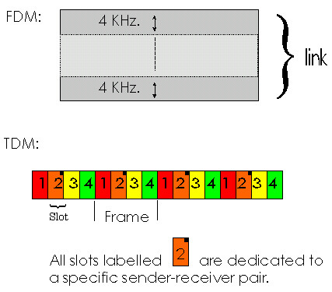
Network Core: Circuit Switching
network resources (e.g., bandwidth) divided into “pieces”
pieces allocated to calls
resource piece idle if not used by owning call (no sharing)
dividing link bandwidth into “pieces”
  frequency division
  time division

Slide 14
Network Core: Packet Switching
each end-end data stream divided into packets
user A, B packets share network resources
each packet uses full link bandwidth
resources used as needed,
resource contention:
aggregate resource demand can exceed amount available
congestion: packets queue, wait for link use
store and forward: packets move one hop at a time
  transmit over link
  wait turn at next link
Bandwidth division into “pieces”
Dedicated allocation
Resource reservation

Slide 15
Network Core: Packet Switching
10 Mbs
Ethernet
A
C
statistical multiplexing
1.5 Mbs
B
queue of packets
waiting for output
link
45 Mbs
D
E
Packet-switching versus circuit switching: human restaurant analogy
other human analogies?

Slide 16
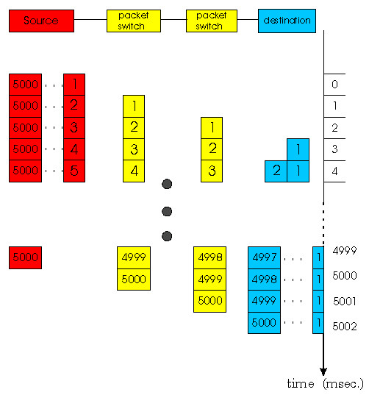
Network Core: Packet Switching
Packet-switching:
store and forward behavior

Slide 17
Packet switching versus circuit switching
Packet switching allows more users to use network!
1 Mbit link
each user:
  100Kbps when “active”
  active 10% of time
circuit-switching:
  10 users
packet switching:
  with 35 users, probability > 10 active less that .004
N users
1 Mbps link

Slide 18
Packet switching versus circuit switching
Is packet switching a “slam dunk winner?”
Great for bursty data
  resource sharing
  no call setup
Excessive congestion: packet delay and loss
  protocols needed for reliable data transfer, congestion control
Q: How to provide circuit-like behavior?
  bandwidth guarantees needed for audio/video apps
  still an unsolved problem (chapter 6)

Slide 19
Packet-switched networks: routing
Goal: move packets among routers from source to destination
  we’ll study several path selection algorithms (chapter 4)
datagram network:
  destination address determines next hop
  routes may change during session
  analogy: driving, asking directions
virtual circuit network:
  each packet carries tag (virtual circuit ID), tag determines next hop
  fixed path determined at call setup time, remains fixed thru call
  routers maintain per-call state

Slide 20
Access networks and physical media
Q: How to connection end systems to edge router?
residential access nets
institutional access networks (school, company)
mobile access networks
Keep in mind:
bandwidth (bits per second) of access network?
shared or dedicated?

Slide 21
Residential access: point to point access
Dialup via modem
  up to 56Kbps direct access to router (conceptually)
ISDN: intergrated services digital network: 128Kbps all-digital connect to router
ADSL: asymmetric digital subscriber line
  up to 1 Mbps home-to-router
  up to 8 Mbps router-to-home
  ADSL deployment: UPDATE THIS

Slide 22
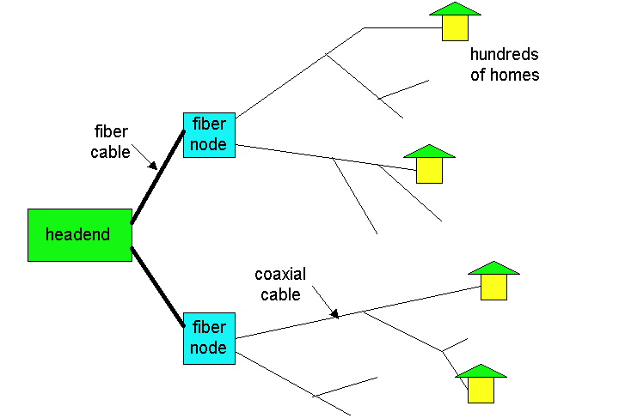
Residential access: cable modems
HFC: hybrid fiber coax
  asymmetric: up to 10Mbps upstream, 1 Mbps downstream
network of cable and fiber attaches homes to ISP router
  shared access to router among home
  issues: congestion, dimensioning
deployment: available via cable companies, e.g., MediaOne

Slide 23
Institutional access: local area networks
company/univ local area network (LAN) connects end system to edge router
Ethernet:
  shared or dedicated cable connects end system and router
  10 Mbs, 100Mbps, Gigabit Ethernet
deployment: institutions, home LANs soon
LANs: chapter 5

Slide 24
Wireless access networks
shared wireless access network connects end system to router
wireless LANs:
  radio spectrum replaces wire
  e.g., Lucent Wavelan 10 Mbps
wider-area wireless access
  CDPD: wireless access to ISP router via cellular network
router
base
station
mobile
hosts

Slide 25
Physical Media
Twisted Pair (TP)
two insulated copper wires
  Category 3: traditional phone wires, 10 Mbps ethernet
  Category 5 TP: 100Mbps ethernet
physical link: transmitted data bit propagates across link
guided media:
  signals propagate in solid media: copper, fiber
unguided media:
  signals propagate freelye.g., radio

Slide 26


Physical Media: coax, fiber
Coaxial cable:
wire (signal carrier) within a wire (shield)
  baseband: single channel on cable
  broadband: multiple channel on cable
bidirectional
common use in 10Mbs Ethernet
Fiber optic cable:
glass fiber carrying light pulses
high-speed operation:
  100Mbps Ethernet
  high-speed point-to-point transmission (e.g., 5 Gps)
low error rate

Slide 27
Physical media: radio
signal carried in electromagnetic spectrum
no physical “wire”
bidirectional
propagation environment effects:
  reflection
  obstruction by objects
  interference
Radio link types:
microwave
  e.g. up to 45 Mbps channels
LAN (e.g., waveLAN)
  2Mbps, 11Mbps
wide-area (e.g., cellular)
  e.g. CDPD, 10’s Kbps
satellite
  up to 50Mbps channel (or multiple smaller channels)
  270 Msec end-end delay
  geosynchronous versus LEOS

Slide 28
Delay in packet-switched networks
packets experience delay on end-to-end path
four sources of delay at each hop
nodal processing:
  check bit errors
  determine output link
queueing
  time waiting at output link for transmission
  depends on congestion level of router
transmission
A
propagation
B
nodal
processing
queueing

Slide 29
Delay in packet-switched networks
Transmission delay:
R=link bandwidth (bps)
L=packet length (bits)
time to send bits into link = L/R
Propagation delay:
d = length of physical link
s = propagation speed in medium (~2x10⁸ m/sec)
propagation delay = d/s
Note: s and R are very different quantitites!
transmission
A
propagation
B
nodal
processing
queueing

Slide 30

Queueing delay (revisited)
R=link bandwidth (bps)
L=packet length (bits)
a=average packet arrival rate
traffic intensity = La/R
La/R ~ 0: average queueing delay small
La/R -> 1: delays become large
La/R > 1: more “work” arriving than can be serviced, average delay infinite!

